Slide 1

Building Relationships and Developing Altruism
________________________________________
by
Dr. Vijai N. Giri
Professor of Communication Studies
Dept. of Humanities & Social Sciences
IIT Kharagpur
email: vng@hss.iitkgp.ernet.in

Slide 2
Why relationship?
_____________________________________
Necessary for survival: food, water, and
shelter
Necessary for feeling of safety.
Finally, individuals seek ‘more human
contacts’.

Slide 3
Tips for communicators
❑ Relationships play an important role in our
life.
❑ There are several characteristics that help to
define relationships.
❑ Relationships influence our behaviour, goals,
and attitudes.
❑ The formulation of relationships depends on
communication.

Slide 4
Characteristics of a Relationship
• Relationships mold people.
• Relationships are subject to human problems.
• Relationships are transitory:
(a) Deep
(b) Moderate
(c) Casual
(d) Passing
Relationship rules cannot be formulated.

Slide 5
Characteristics of a Relationship
Relationship influence people.
(a) Goals
(b) Attitudes
(c) Behaviour
Relationships are activated through
communication.

Slide 6
Awareness
Acquaintance
Ground
breaking
Rapport
building
Mutual needs
not met
Relationship
ends
Exploration
Negotiation
Self-disclosure
Identification
Relationship
development
Breakdown

Slide 7
Stages in the Formation of a Relationship:
• Awareness
• Acquaintance
• Ground breaking
• Rapport building
• Exploration:
(a) Seeking information
(b) Giving information

Slide 8
Stages in the Formation of a Relationship
• Negotiation
• Self-disclosure:
(a)Formation of bonds
(b) Reduced need for further testing
• Identification:
(a) Efforts made to determine the partner’s needs.
(b) Efforts made to fulfil the partner’s needs.
• Breakdown

Slide 9
What we look for in relationships
• We look for someone like ourselves.
• We look for people who can do something for us.
• We look for someone who can help keep us in balance.
• We look for someone who is dynamic and sociable.

Slide 10
Altruism Defined
Rooted in the Latin word alter – meaning other
Altruism – means “living for others”
Key component – selflessness – an unselfish regard for the welfare of others.
This word was coined by the French philosopher Auguste Comte in French, as altruisme, for an antonym of egoism.
Altruism means willingness to do things that bring advantages to others, even if it results in disadvantage for ourselves. Altruism or selflessness is the principle or practice of concern for the welfare of others.

Slide 11
Developing Altruism
Altruism in biological organisms can be defined as an individual performing an action which is at a cost to themselves (e.g., pleasure and quality of life, time, probability of survival or reproduction), but benefits, either directly or indirectly, another third-party individual, without the expectation of reciprocity or compensation for that action.

Slide 12
Altruism in Traditions
Giving alms to the poor is often considered an altruistic action.
Most of the world's religions promote altruism as a very important moral value. Buddhism, Christianity, Hinduism, Islam, Jainism, Judaism, Sikhism, etc., place particular emphasis on altruistic morality.

Slide 13
Learning to Help
The culture into which one is born will shape our altruistic tendencies.
We learn norms from our group through the process of socialization.

Slide 14
Exercise
Develop a list of ten most frequently occurring problems in relationships.
What relationship has had the greatest impact on your behaviour, attitudes and goals? Tell, briefly how this relationship has influenced you.
What kind of altruism do you feel the best? Why?

Slide 15
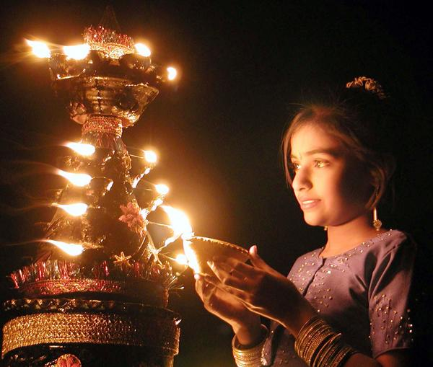
Thank You

